Slide 1
MGB2340
MONASH Business School
Lecture 2 – Strategic Issues in HRM

Slide 2
Learning Outcomes
Define and describe the strategic management process
2. Examine theoretical approaches that integrate HR with and the strategic management process
3. Consider the ‘HR Black Box’ and the role of the HR function

Slide 3
RESEARCH REFRESHER. IN BRIEF….
“Theories are generalisations about what exists in the world around us and how components of that world fit together in patterns” O’Brien and Penna, 1998, p.3
Theories – often summarised in the form of conceptual models – depict how things are reasoned to operate in practice. Empirical research tests theory, resulting in theoretical, empirical and practical contributions, as well as directions for future research and development.
Empirical research methods can be qualitative (typically interviews, observation…), quantitative (statistical) or a mix of both (mixed method). The research method is determined by the research questions/hypotheses of a study.

Slide 4
Strategic Management
A process or approach to addressing the competitive challenges faced by an organisation. …the ‘pattern or plan that integrates an organisation’s major goals, policies and action sequences into a cohesive whole’ (Quinn, 1980).
Components:
Strategic formulation – the process of deciding on a strategic direction by defining a company’s mission and goals, its external opportunities and threats and its internal strengths
Strategic implementation – the process of devising structures and allocating resources to enact the strategy a company has chosen

Slide 5

What is Strategy?
Strategies define the direction in which an organisation intends to move and establishes a framework for action to achieve a particular strategy
Capitalising on strengths and opportunities
Minimising weaknesses and threats

Slide 6

What is Strategy?
Chandler (1962)
Basic long-term goals & objectives of an enterprise i.e. DIRECTION
Adoption of courses of action i.e. ACTION
Allocation of resources needed to carry out goals
Porter (1979, 1980, 1985)
Positioning- defining a company’s position relative to its competitors in the industry
where to compete, on what criteria, with what resources

Slide 7
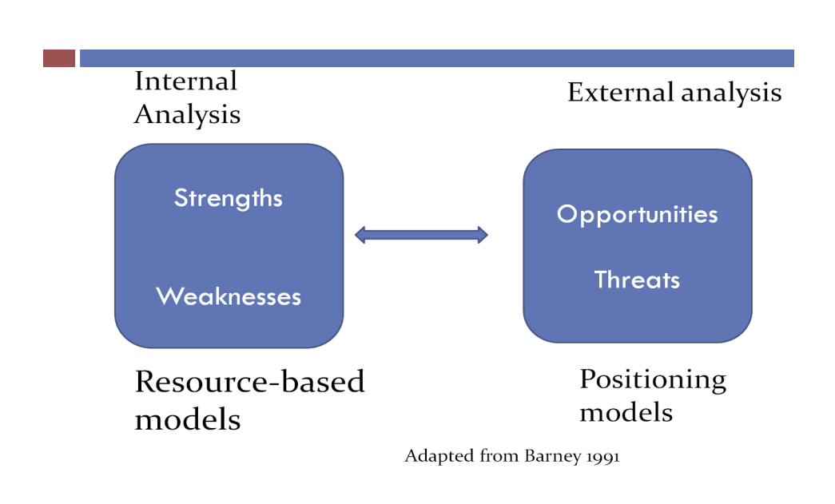
What is Strategy?

Slide 8

Types of Strategy
DIRECTIONAL (CORPORATE LEVEL) STRATEGIES Where do we compete? What business are we in?
Concentration strategies
Maintain strong relevant skill base Internal growth strategies
Transferring staff into different markets
External growth strategies
Aligning cultures and practices
Divestment or downsizing (outsourcing) strategies
Outsourcing certain functions (HR/Finance)

Slide 9

Types of Strategy
COMPETITIVE STRATEGIES
How do we compete in that business?
Generic strategic types
Cost
Quality
Innovation
Strategic choice
The organisation’s strategy; the ways an organisation will attempt to fulfill its mission and achieve its long-term goals.
But these choices are bounded by contingencies such as industry, markets and competitors, technology etc

Slide 10

HR and the Strategic Management Process
A light-hearted take on SHRM:Goodfella’s https://www.youtube.com/watch?v=CgggItUc6LQ

Slide 11
HR and the Strategic Management Process
Strategic Management
Aims to achieve and sustain competitive advantage
How, when and where to compete
Strategic choice depending on mission and goals of the organisation, competitive environment, technology
Strategic HRM
“The pattern of planned HR deployments and activities intended to enable the firm to achieve its goals” (Kramar et al 2014:56).
Employees are viewed resources that can be exploited/influenced to achieve and sustain competitive advantage
Strategic choices are made about how HRM system depending on business strategy.
HRM’s role is to ensure a company’s human resources provide it with a competitive advantage

Slide 12
The Resource Based View (RBV)
HRM can play a strategic role by seeking sources of internal competitive advantage (Your Employees) that are valuable, rare, inimitable and non-substitutable.
The resource-based view of HRM (RBV) (Barney and Wright, 1998) hypothesised that people and (more importantly) how they are managed are a source of competitive advantage (ie People are the most valuable resource)

Slide 13
Strategic HRM

Slide 14
Definitions of SHRM
“the pattern of planned human resource deployments and activities intended to enable an organization to achieve its goals” (Wright & McMahan, 1992: 298)
SHRM is “devoted to exploring HR’s role in supporting business strategy” (Wright, Dunford & Snell, 2001: 701)
SHRM implies a concern with the ways in which HRM is critical to organisational effectiveness (Boxall & Purcell, 2000: 183)

Slide 15
Approaches to SHRM
Best Practice (Universalist approach) posits that some HR practices are always better than others and all organisations should adopt them (Pfeffer, 1984)
Best Fit (Contingency approach) HR strategy will be more effective when it is appropriately integrated with its specific organisational and broader environmental context.
The configurational approach HR strategy will be more effective when it is appropriately integrated with its specific organisational and broader environmental context.

Slide 16

Approaches to SHRM
BEST PRACTICE
support for micro level best practice HRM in the areas of selection, training and appraisal
the importance of the structured interview around job relevant factors for example is largely accepted
value of ability testing
executives are better suited to outcomes based rather than behavioural performance appraisals
BUT Political, labour, union and cultural differences weaken BP relevance, and,
Too many ‘best practice’ models
Lack of specified pathways to achieve improved performance.

Slide 17

Approaches to SHRM
BEST FIT
Considers the organisation life cycle;
Strategic management styles, defenders, analysers, prospectors reactors (Miles and Snow (1978, 2000); and, Key strength:
Integrates HR with the organisation and the environment Some criticisms:
Overly simplistic – fit is complex
Focus on org level – lack of consideration of employee interests

Slide 18
Approaches to SHRM
CONFIGURATIONAL - INTEGRATION AND ADAPTATION
Its concern is to ensure:
HRM is fully integrated with organisational strategy;
Coherent HR policies /activities (internal synergy)
Involvement of line managers and employees.
Linking people management to strategy is primarily concerned with explaining why some firms succeed, whilst others do not.
Strategic HRM is concerned with understanding the unique contribution of HR to business performance.
First order goals:
Productivity – making labour productive
Adaptability – flexibility
Legitimacy

Slide 19

Issues and Tensions in HRM
The problem of labour scarcity
Labour motivation V control
Change tensions – flexibility vs commitment
Management power V social legitimacy
Complexity and politics in management
Variations in institutional supports and societal resources (Boxall & Purcell 2011)

Slide 20
Issues and Tensions in HRM
Line Manager Influence
Ties usually stronger between a work team and line manager than with higher management:
The ‘immediate supervisor plays a critical role as a key agent of the organisation through which members form their perceptions of the organisation’ (Liden, Bauer and Erdogan, 2004);
Thus, research on the links between HRM and performance needs to take account of the mediating role of line managers

Slide 21
Issues and Tensions in HRM
Respect for the HR Professional
Keith H. Hammond in his 2005 Fast Company article, Why We Hate HR
“..HR is the corporate function with the greatest potential and also the one that most consistently under delivers”
According to Boxall and Purcell (2011):
HR needs to be supported by the actions of line managers and the support of members of the top management team (TMT)
In practice this may not be the case (policy v practice).

Slide 22

A Strategy for HR
Strong HRM = High in distinctiveness, consistency and consensus
(Bowen & Ostroff, 2004)

Slide 23
Strong HRM
Distinctiveness
Features that allow the HRM practice to stand out in the work environment
Visibility – the degree to which these practices are readily observable
Understandability – A lack of ambiguity and ease of comprehension of HRM practice content
Legitimacy of authority – whether the HRM function is perceived as a high-status, high credibility function and activity
Relevance – whether HRM practices are defined In such as way that employees see these practices as relevant to a shared goal

Slide 24
Strong HRM
Consistency
Is established when there is agreement amongst employees and managers
Agreement among principle HRM decision makers
Fairness of the HRM systems

Slide 25
Strong HRM
Consensus
Establishing an effect over time whereby the effect occurs each time the entity is present, regardless of the form of interaction
Instrumentality – establishing an unambiguous perceived cause-effect relationship in the reference to HRM systems’ desired content-focused behaviours and associated employee consequences
Validity– HRM practices must display consistency between what they claim to do and what they do
Consistency– convey compatibility and stability in the signals sent by HRM practices

Slide 26
Summary
Strategic HRM – HR activities and policies are integrated and deployed to achieve business strategy
The resource-based view of HRM offers insights into how HR practitioners can create and sustain competitive advantage through a firm’s human resources and offers an alterative to the positioning school
Approaches to HR content design include best practice and best fit approaches.
As well as HR content, HR still has to ensure that the process through which HR is enacted supports HR initiatives – this includes line manager readiness to support HR and top management team support for HRM.

